Slide 1
Micro Credit Defaulter Project
By: Deepak kr. Singh

Slide 2

Microfinance (a brief description about Indonesians MFI)
Microfinance Law, which are intended as a catalyst for domestic banks to provide basic banking and insurance services to a higher number of low-income Indonesians in remote places.
A report says Only around 22% of Indonesians are connected to formal financial institutions. Accessible for people in remote areas and on small islands, not just people in the cities. This is why micro-finance, like micro-banking and micro-insurance, is becoming so important.

Slide 3

Introduction
A Microfinance Institution (MFI) is an organization that offers financial services to low income populations. MFS becomes very useful when targeting especially the unbanked poor families living in remote areas with not much sources of income. The Microfinance services (MFS) provided by MFI are Group Loans, Agricultural Loans, Individual Business Loans and so on.
Today, microfinance is widely accepted as a poverty-reduction tool, representing $70 billion in outstanding loans and a global outreach of 200 million clients.
Many microfinance institutions (MFI), experts and donors are supporting the idea of using mobile financial services (MFS) which they feel are more convenient and efficient, and cost saving, than the traditional high-touch model used since long for the purpose of delivering microfinance services. Though, the MFI industry is primarily focusing on low income families and are very useful in such areas, the implementation of MFS has uneven with both significant challenges and successes.

Slide 4

We are working with client that is in Telecom Industry .They have launched various products and have developed its business and organization based on the budget operator model, offering better products at Lower Prices to all value conscious customers through a strategy of disruptive innovation that focuses on the subscriber.
Telecom Industry understand the importance of communication and how it affects a person’s life, thus, focusing on providing their services and products to low income families and poor customers that can help them in the need of hour.
They are collaborating with an MFI to provide micro-credit on mobile balances to be paid back in 5 days. The Consumer is believed to be defaulter if he deviates from the path of paying back the loaned amount within the time duration of 5 days. For the loan amount of 5 (in Indonesian Rupiah), payback amount should be 6 (in Indonesian Rupiah), while, for the loan amount of 10 (in Indonesian Rupiah), the payback amount should be 12 (in Indonesian Rupiah).

Slide 5
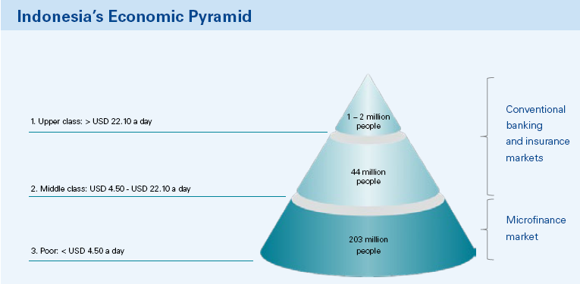
Indonesia Economic survey
203 million, or 81.5% of Indonesians are at the bottom of the economic pyramid
Microfinance involves the supply of financial services to poor or low-income earning individuals and companies, which may include micro-credit.
In Indonesia the banks and MFI :
1195 commercial banks
1,6435 rural banks
Up to 600,0006 other Micro finance institutions (MFIs)

Slide 6

Project Goal
Analytical Problem Framing
EDA
Visualizations
Data Pre-processing on Train & test dataset
Model development and Evaluation
Performing Hyper-parameter Tuning
Best Fit Model and prediction
Conclusion

Slide 7
Exploratory Data Analysis (EDA)
This section shows the exploration done on the dataset, which is what motivated the use of the algorithm.
A significant relationship between Non-defaulter & defaulter.
Dataset is imbalanced. Label ‘1’ has approximately 87.5% records, while, label ‘0’ has approximately 12.5% records.
Training phase: The system is trained by using the data set and fits a model
Testing phase: The system is provided with the inputs and is tested for its working. The accuracy is checked
Shape : 2,09,593 rows and 37 columns
No null values present
No Duplicate record found
Datatypes of float, integer and object are in dataset

Slide 8
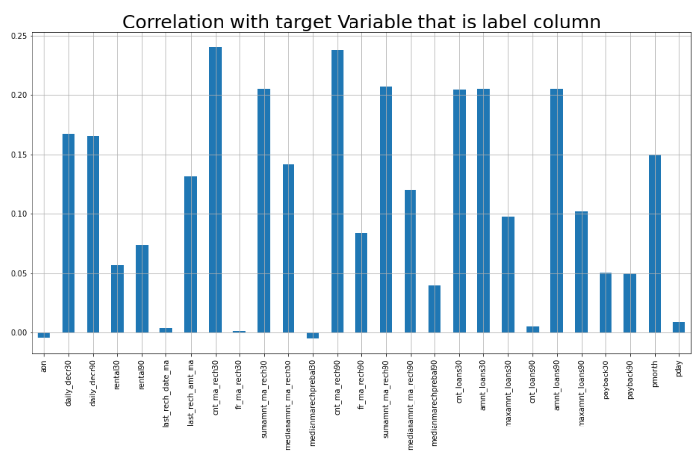
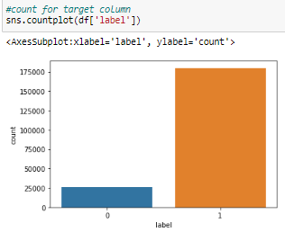
Visualizations

Slide 9
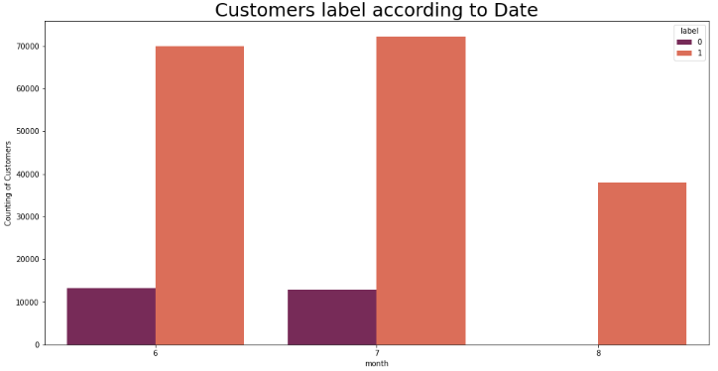
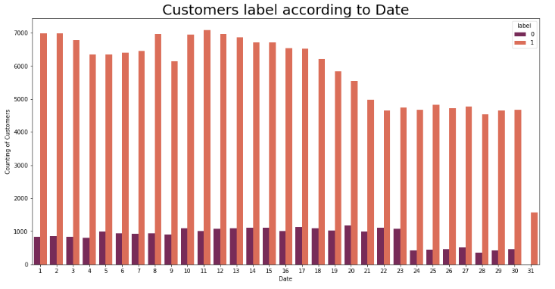
Loan count as per date and month (Non-defaulter and Defaulter):

Slide 10
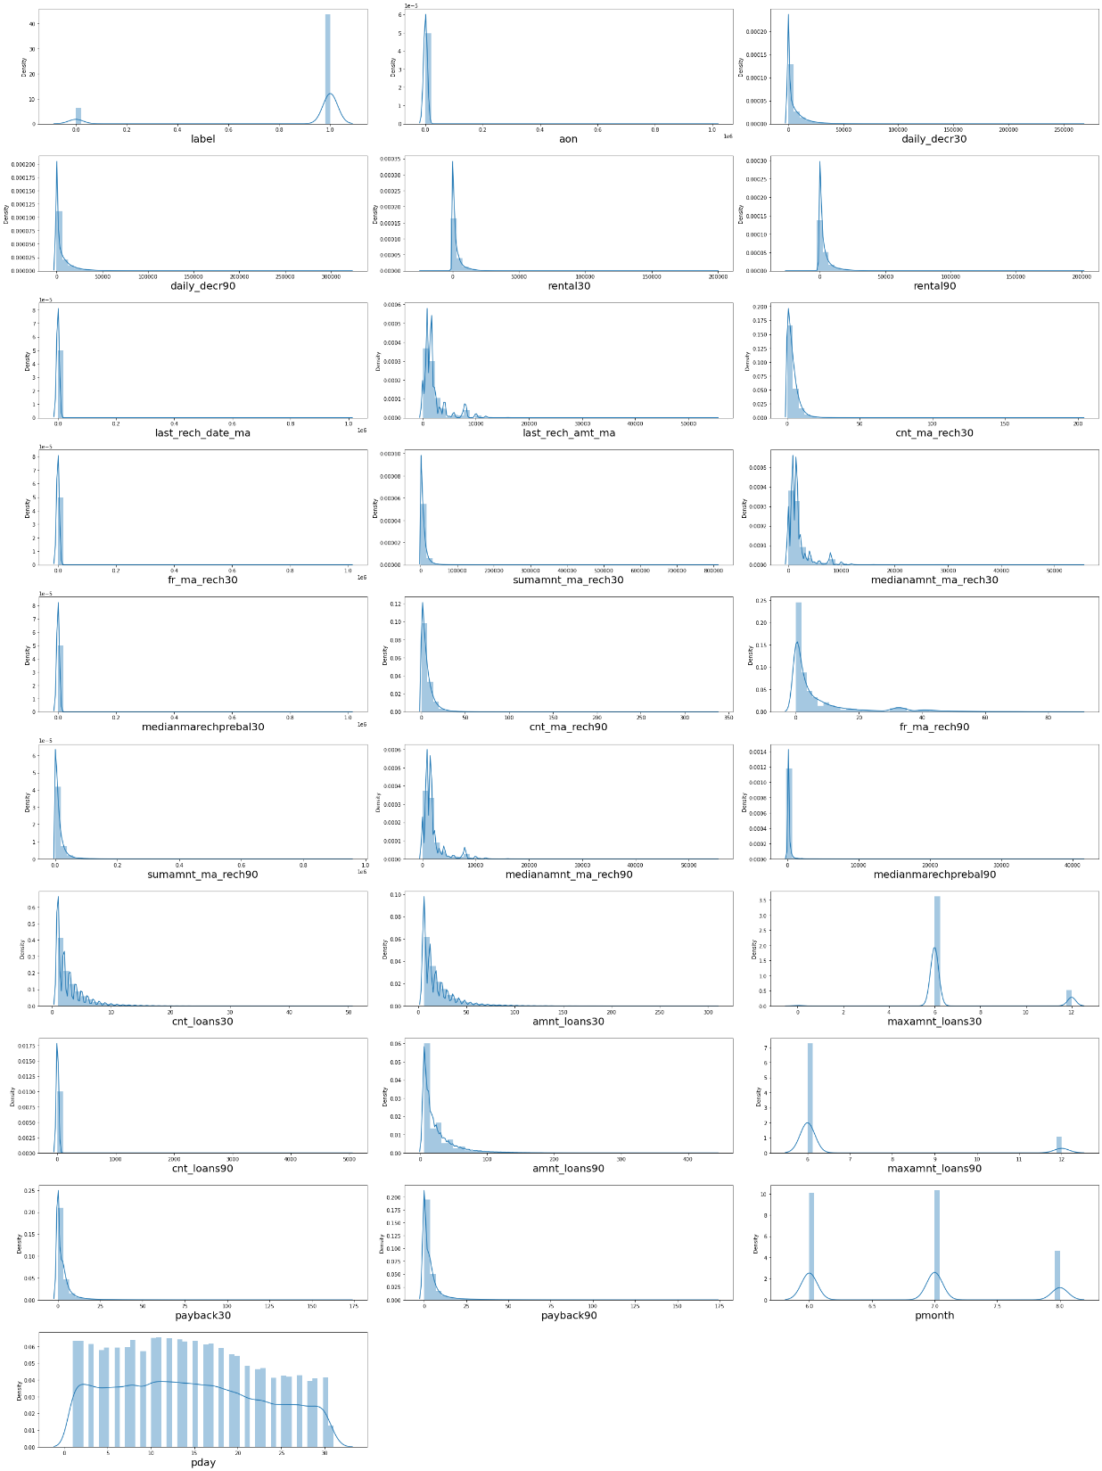
Multivariate Analysis
Distribution plot to check through all the column details ensuring that the distribution is displayed for further analysis

Slide 11
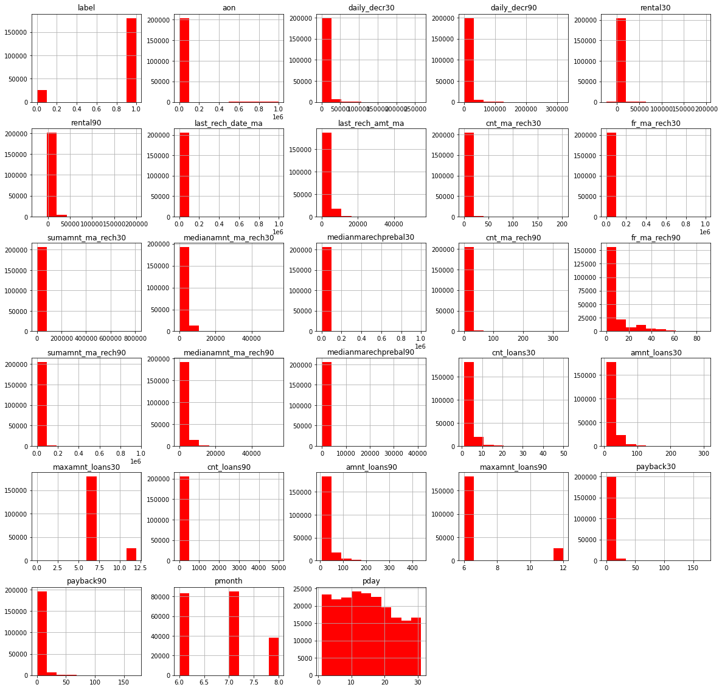
Plotting the Histogram

Slide 12
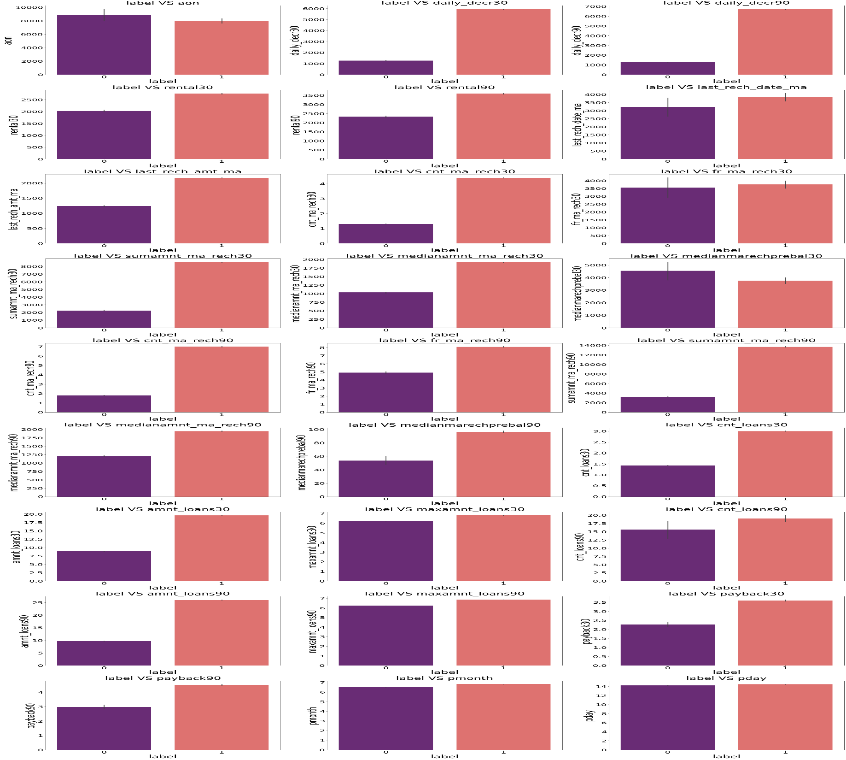
Bivariate Analysis
With the help of Bar Plot we are able to see the success and failure label data for the columns basically the feature data.

Slide 13
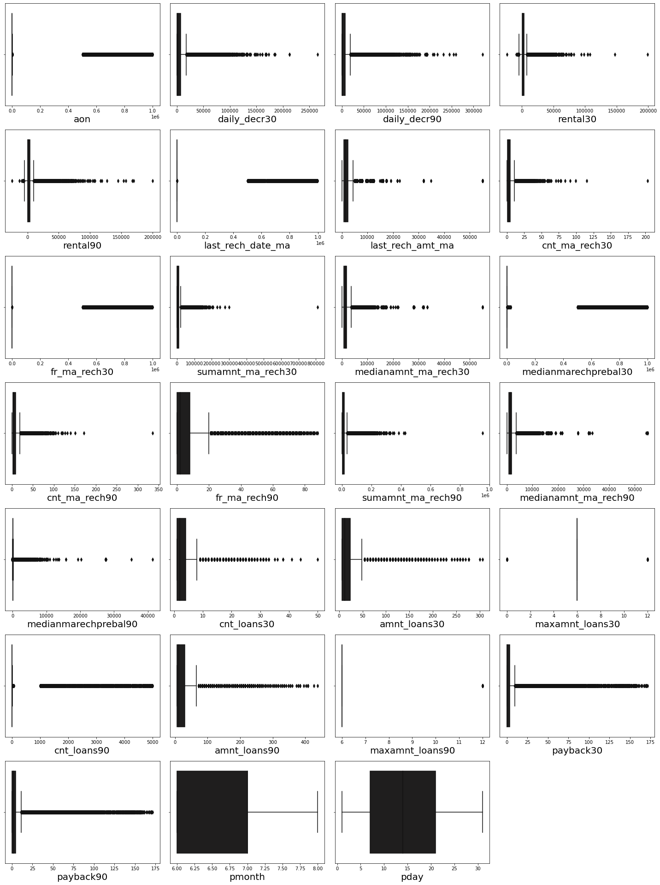
statistical representation of the all the numeric data columns.
In that have outliers so treat them with different methods

Slide 14

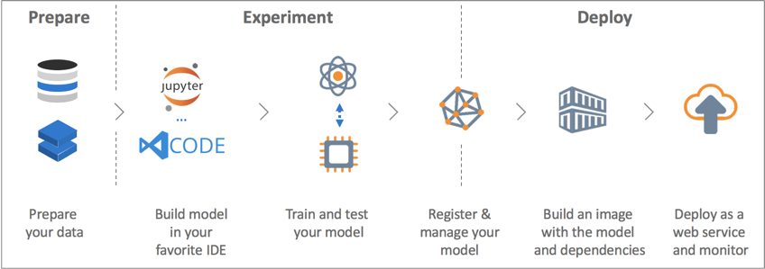
Model building
Built model which can be used to predict in terms of a probability for each loan transaction, whether the customer will be paying back the loaned amount within 5 days of insurance of loan.
In this case, Label ‘1’ indicates that the loan has been payed i.e. Non- defaulter, while, Label ‘0’ indicates that the loan has not been payed i.e. defaulter.

Slide 15
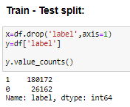
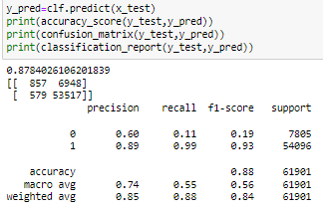
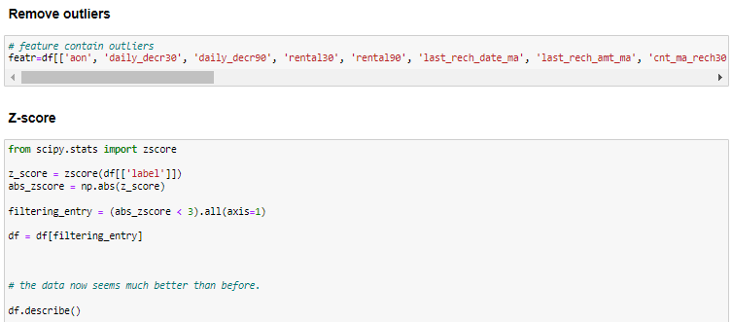
Accuracy score of train-test:
Models: Random Forest Classifier, Decision Tree Classifier, Ada Boost Classifier, Gradient Boosting Classifier, Bagging Classifier, XGB Classifier, SGD Classifier were our baseline methods.
For model implementations, the open-source Scikit-Learn package used

Slide 16
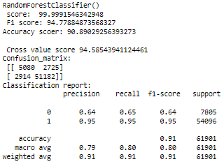
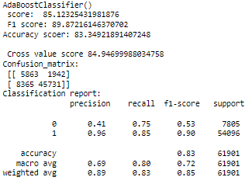
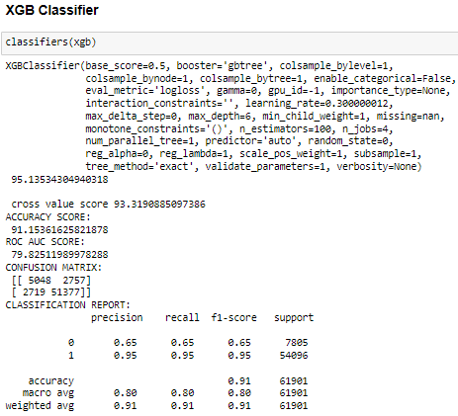
Models:
Random Forest Classifier
Ada-Boost Classifier

Slide 17
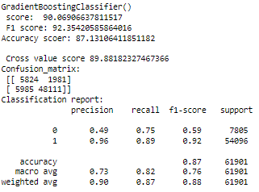
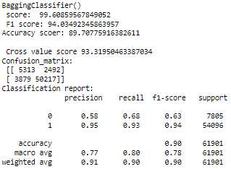
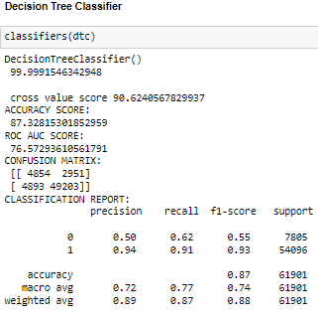
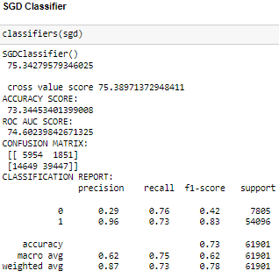
Gradient Boosting Classifier
Bagging Classifier

Slide 18
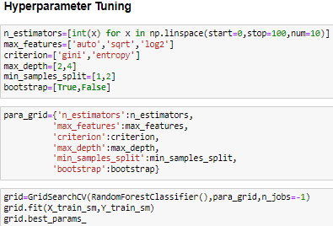
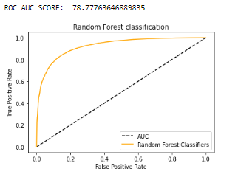
Hyper-parameter Tuning and ROC & AUC SCORE
ROC curves and AUCs are used to measure the quality of a classifier’s output; thus, they measure how correctly a classifier has been tuned. Movement along the ROC curve is typically a trade-off between the classifier’s sensitivity (true positive rate (TPR))

Slide 19
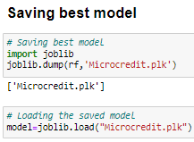
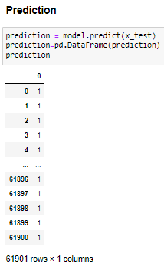
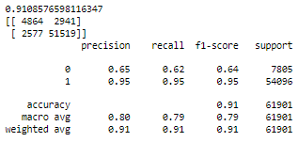
Best Fit Model
The best model with 91.18% accuracy score
Database help in making perfect model & help in understanding Indonesian micro finance services (MFS)

Slide 20
CONCLUSION
In this project report, evaluated individuals’ credit risk performance in a micro-finance environment using machine learning and deep learning techniques we have used machine learning algorithms to predict the micro credit defaulters. We have mentioned the step by step procedure to analyze the dataset and finding the correlation between the features. Thus we can select the features which are correlated to each other and are independent in nature.
These feature set were then given as an input to four algorithms and a hyper parameter tuning was done to the best model and the accuracy has been improved. Hence we calculated the performance of each model using different performance metrics and compared them based on these metrics. Then we have also saved the best model and predicted the label. It was good the the predicted and actual values were almost same.

Slide 21

Limitations of this work & Scope for Future Work
First draw back is the length of the dataset it is very huge and hard to handle.
Followed by more number of outliers and skewness these two will reduce our model accuracy.
Also, we have tried best to deal with outliers, skewness and zero values. So it looks quite good that we have achieved a accuracy of 91.32% even after dealing all these drawbacks.
Also, this study will not cover all Classification algorithms instead, it is focused on the chosen algorithm, starting from the basic ensembling techniques to the advanced ones

Slide 22


